Slide 1


IBM Data Science Course
Final Project
Margarita Zhurenkova
8/17/2022

Slide 2

Outline
Executive Summary
Introduction
Methodology
Results
Conclusion
Appendix

Slide 3
Executive Summary
Public information from SpaceX api and Wikipedia was used to train a machine learning model and use it to predict if SpaceX reuses the first stage of the Falcon 9 rocket (if the launch is successful or not).
Results of data analysis are visualized with graphs, maps and interactive dashboard.
The best orbits and launch site were defined.

Slide 4
Introduction
SpaceX advertises Falcon 9 rocket launches on its website with a cost of 62 million dollars; other providers cost upward of 165 million dollars each, much of the savings is because SpaceX can reuse the first stage.
Therefore if we can determine if the first stage will land, we can determine the cost of a launch.
In this project a model was built to predict, if the Falcon 9 first stage lands successfully.

Slide 5

Section 1

Slide 6
Methodology
Executive Summary
Data collection methodology:
Data was collected by the Request to the SpaceX API;
Date was collected by web scraping to collect Falcon 9 historical launch records from a Wikipedia page;
Exploratory data analysis (EDA) using visualization and SQL;
Interactive visual analytics using Folium and Plotly Dash;
Predictive analysis using classification models:
Best Hyperparameter for SVM, Classification Trees, Logistic Regression and KNN were found;
The best result was achieved with Classification Trees.

Slide 7
Data Collection
2 methods of data collection were used:
From SpaceX api
As Web Scrapping from Wikipedia

Slide 8
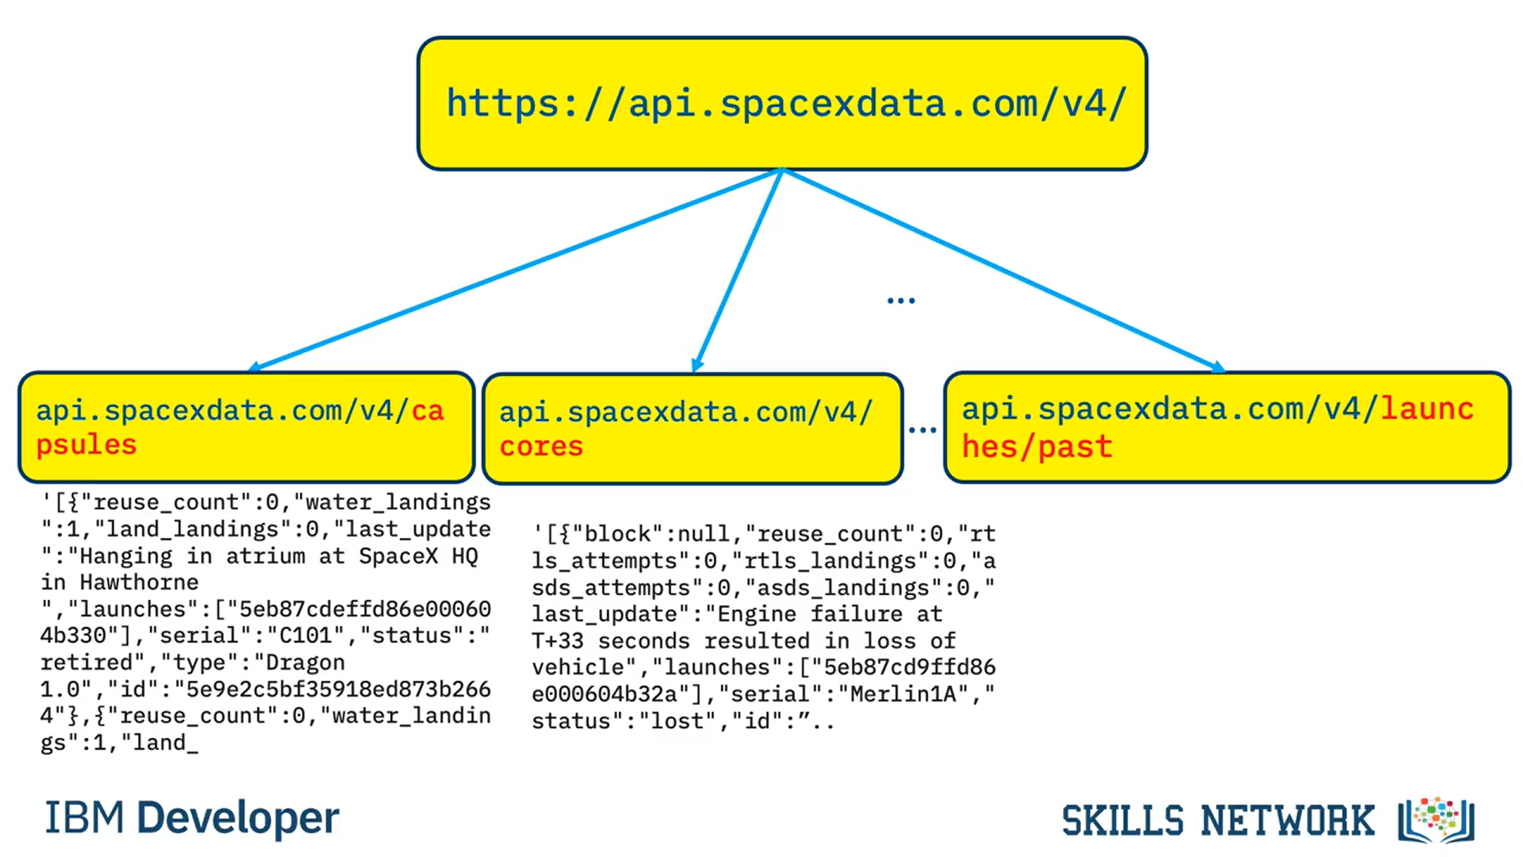
Data Collection – SpaceX API
Api.spacexdata.com/v4/launches/past was used;
Get request was performed with a list of .json objects as result ;
Converted into Pandas Data Frame with normalize function;
GitHub URL of the completed SpaceX API calls notebook

Slide 9
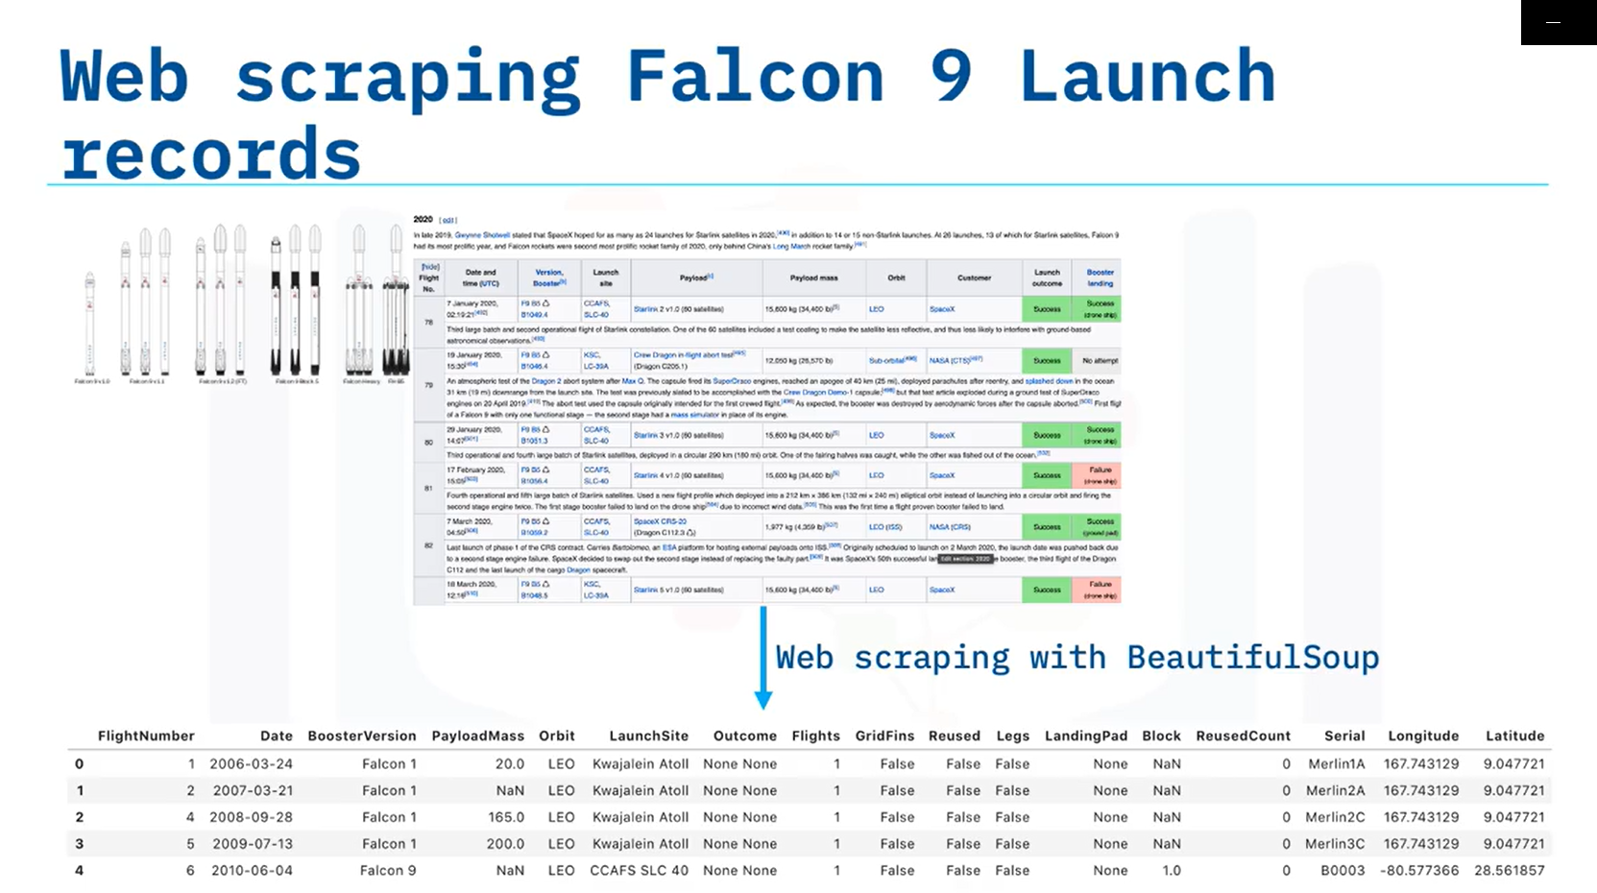
Data Collection – Web Scraping
Web scraping with BeautifulSoup package from Wikipedia (static version url from at 11:39, 9 June 2021);
Parced and converted data into Pandas Data Frame (id numbers were replaced by data from API, null values were replaced by mean values)
Falcon 1 data was removed from the table
GitHub URL of the completed web scraping notebook

Slide 10
Data Wrangling
Exploratory Data Analysis (EDA) was performed to find some patterns in the data and determine what would be the label for training supervised models.
In the data set, there are several different cases where the booster did not land successfully:
True Ocean means the mission outcome was successfully landed to a specific region of the ocean ;
False Ocean means the mission outcome was unsuccessfully landed to a specific region of the ocean;
True RTLS means the mission outcome was successfully landed to a ground pad ;
False RTLS means the mission outcome was unsuccessfully landed to a ground pad;
True ASDS means the mission outcome was successfully landed on a drone ship ;
False ASDS means the mission outcome was unsuccessfully landed on a drone ship.
Those outcomes were converted into Training Labels y with 1 means the booster successfully landed 0 means it was unsuccessful.
GitHub URL of the completed data wrangling related notebook

Slide 11
EDA with Data Visualization
Scatter Plot, Bar chart and Line graph were used:
Scatter Plot showed the distribution of successful and unsuccessful launches and the relation between order of launches or payload mass and Launch Site, and Orbit.
Bar chart showed the success rate for each orbit.
Line graph was built to show the trend for success rate over the years 2010-2020.
GitHub URL of the completed EDA with data visualization notebook

Slide 12
EDA with SQL
SQL queries performed:
Unique Launch Sites were found using DISTINCT query;
Total payload was calculated using SUM query;
Average payload, which was carried by specific booster was found with AVG query;
First specific successful landing outcome was found using ORDER BY and ASC query;
Several queries were done using subquery, GROUP BY and taking into account DATE restrictions.
GitHub URL of the completed EDA with SQL notebook

Slide 13
Build an Interactive Map with Folium
The launch success rate may also depend on the location and proximities of a launch site, i.e., the initial position of rocket trajectories.
Finding an optimal location for building a launch site certainly involves many factors and we could discover some of the factors by analyzing the existing launch site locations.
Markers and circles for Successful and Unsuccessful launches were used to help to choose the location with highest success rate.
Using lines and we could indicate proximities with Neighbour objects such as roads and railways.
GitHub URL of the completed interactive map with Folium map

Slide 14
Build a Dashboard with Plotly Dash
This dashboard application contains input components such as a dropdown list and a range slider to interact with a pie chart and a scatter point chart.
Pie chart was chosen to show the rate of successful and unsuccessful launches.
Scatter plot with payload range slider helps to choose the payload range with higher success rate.
GitHub URL of the completed Plotly Dash
GitHUB URL for Dashboard

Slide 15
Predictive Analysis (Classification)
Machine learning pipeline was built to predict if the first stage of the Falcon 9 lands successfully. It included:
Preprocessing to standardize the data,
Train_test_split to split the data into training and testing data,
Train the model and perform Grid Search to find the hyperparameters that allow a given algorithm to perform best,
Using the best hyperparameter values to determine the model with the best accuracy using the training data.
Were trained: Logistic Regression, Support Vector machines, Decision Tree Classifier, and K-nearest neighbors.
Based on accuracy and the confusion matrix the best algorithm was chosen :
Decision Tree Classifier.
GitHub URL of the completed predictive analysis

Slide 16
Results
Exploratory data analysis results
Interactive analytics demo in screenshots
Predictive analysis results

Slide 17

Section 2

Slide 18
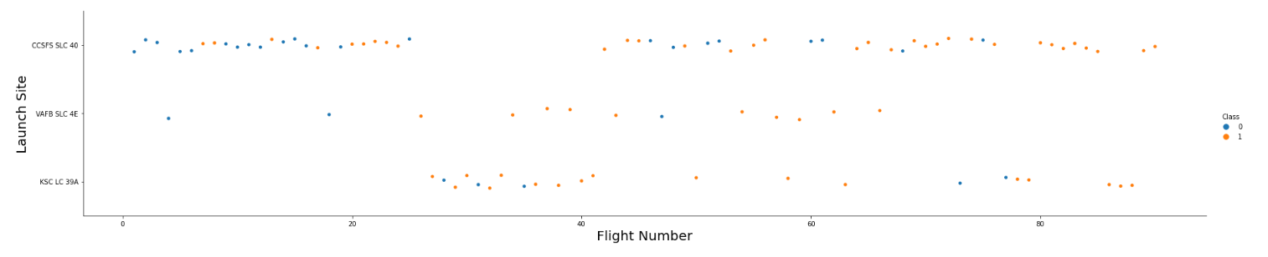
Flight Number vs. Launch Site
Scatter plot of Flight Number vs. Launch Site
In this graph we can see that the first launches and the majority of launches were done from CCAFS SLC-40, the latest launches were successful from all Sites.

Slide 19
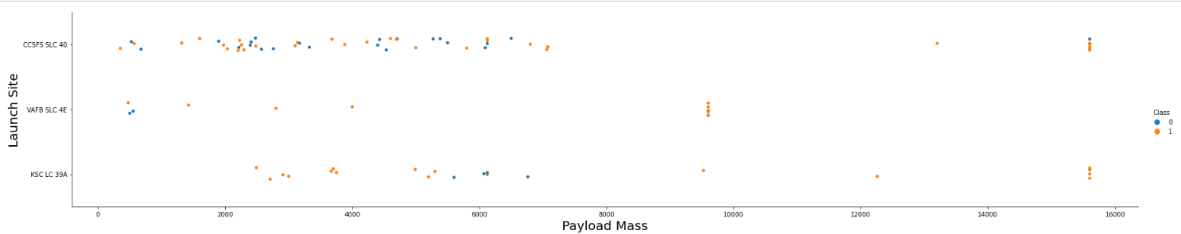
Payload vs. Launch Site
Scatter plot of Payload vs. Launch Site
We can see that from the VAFB-SLC launch site there are no rockets launched
for heavy payload mass(greater than 10000).
Also the majority of heavy payload launches were successful.
There seems to be no relationship between payload mass and success rate for CCAFS SLC-40 Site.

Slide 20
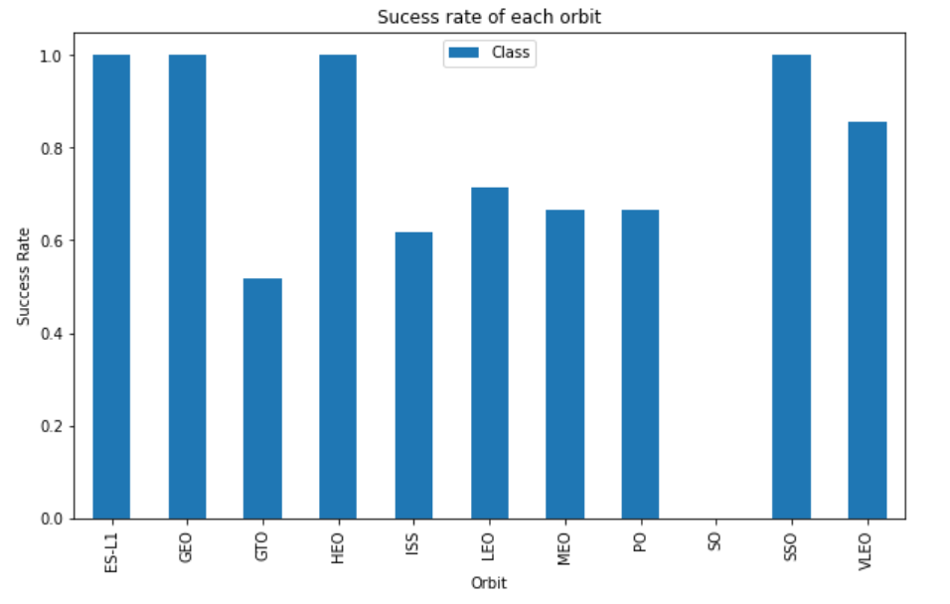
Success Rate vs. Orbit Type
Bar chart for the success rate of each orbit type.
Orbit types are described in the Appendix.
The highest success rates have ES-L1, GEO, HEO and SSO orbits.
The lowest one – GTO.
And SO orbit has no rate (most probably it's a mistype of SSO)

Slide 21
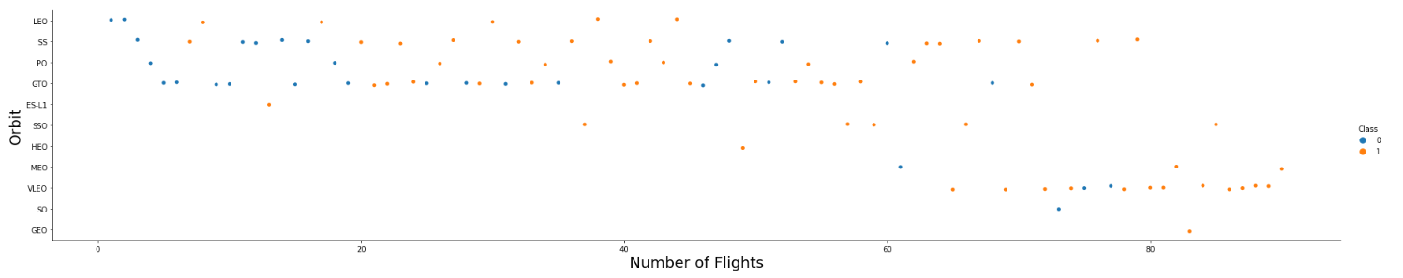
Flight Number vs. Orbit Type
Scatter point of Flight number vs. Orbit type
In the LEO orbit the Success appears to be related to the number of flights; on the other hand, there seems to be no relationship between flight number when in GTO orbit.
Some orbits have a very limited number of launches (such as GEO with 1 launch) - so it would be impossible to use this data for predictions for these orbits.

Slide 22
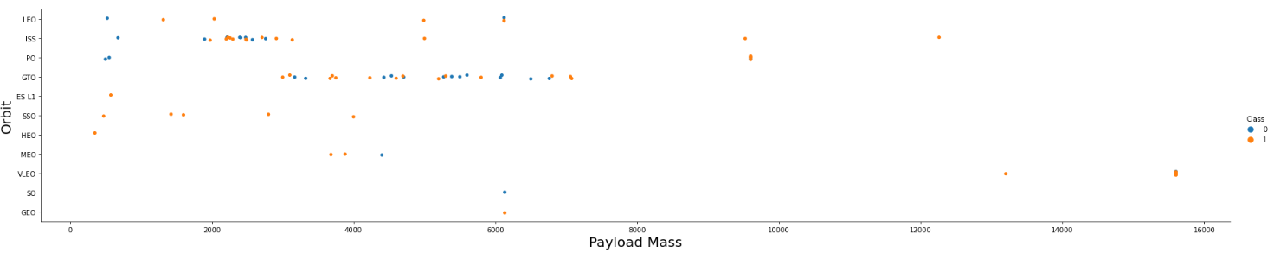
Payload vs. Orbit Type
Scatter point of payload vs. orbit type
With heavy payloads the successful landing or positive landing rate are more for Polar, LEO and ISS.
However for GTO we cannot distinguish this well as both positive landing rate and negative landing(unsuccessful mission) are there .

Slide 23
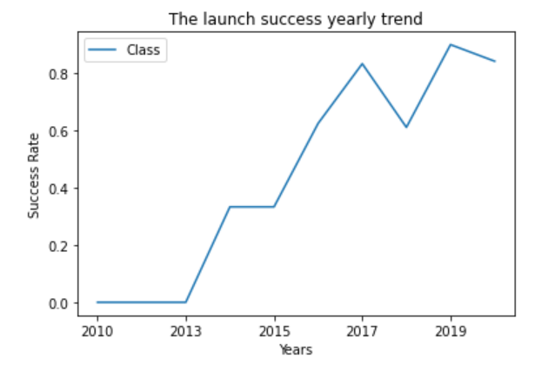
Launch Success Yearly Trend
Line chart of yearly average success rate between 2010 and 2020.
The success rate since 2013 keeps increasing, which is well explained with the growth of the maturity level of the SpaceX researches and experience.

Slide 24
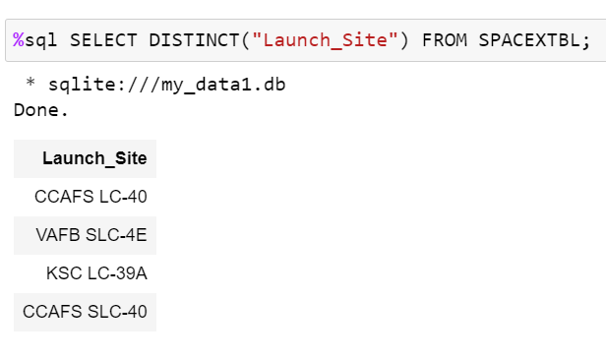
All Launch Site Names
There are 4 unique Launch Sites in our table:
CCAFS LC-40
VAFB SLC-4E
KSC LC-39A
CCAFS SLC-40
The result is an SQL query via SQLite in Python.

Slide 25
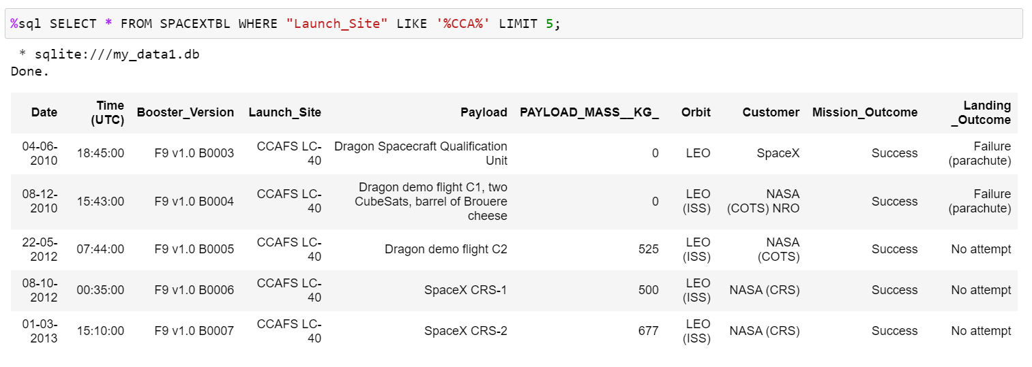
Launch Site Names Begin with 'CCA'
5 records where launch sites begin with `CCA`:
The result is an SQL query via SQLite in Python.​

Slide 26
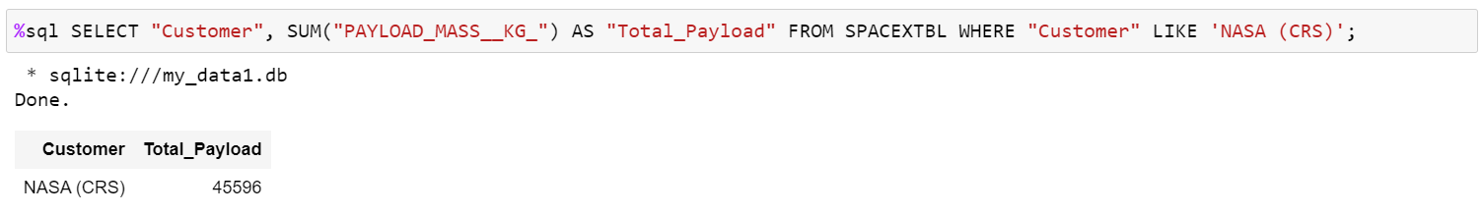
Total Payload Mass
The total payload carried by boosters from NASA: 45596 kg.
The result is an SQL query via SQLite in Python.​

Slide 27
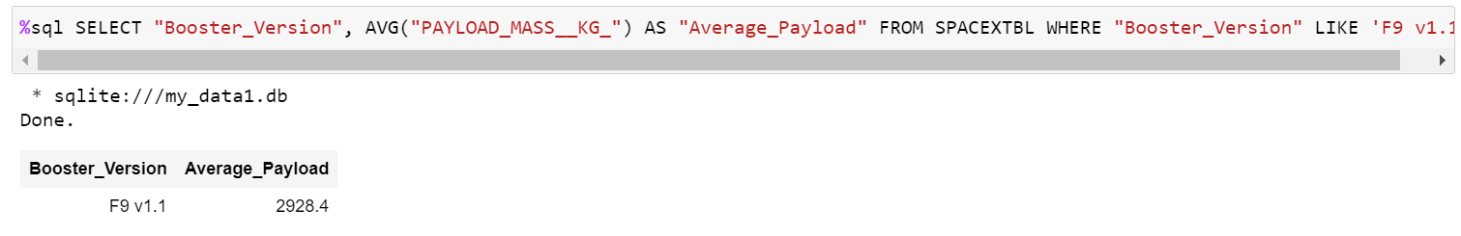
Average Payload Mass by F9 v1.1
The average payload mass carried by booster version F9 v1.1: 2928.4 kg.
The result is an SQL query via SQLite in Python.​

Slide 28
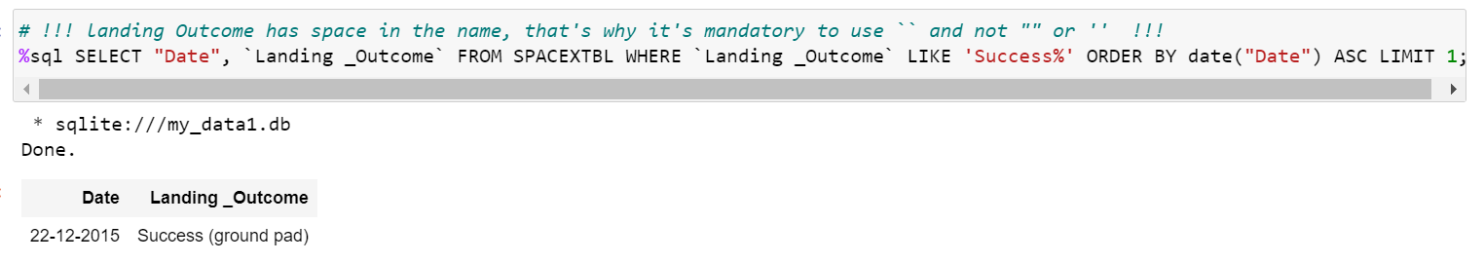
First Successful Ground Landing Date
The date of the first successful landing outcome on ground pad:
22nd of December 2015
The result is an SQL query via SQLite in Python.​

Slide 29
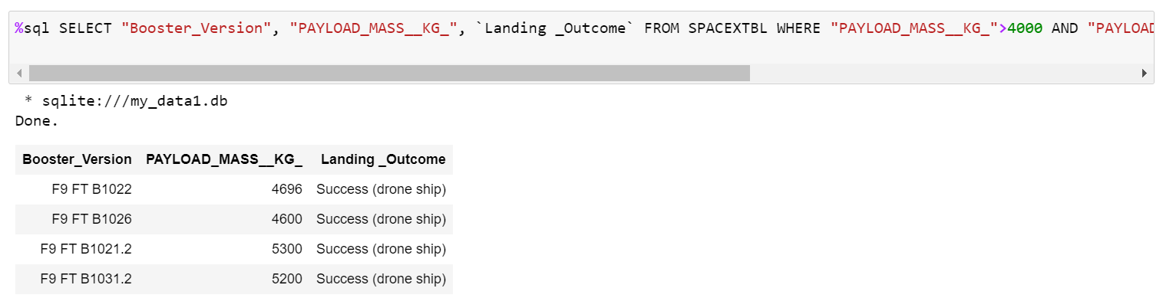
Successful Drone Ship Landing with Payload between 4000 and 6000
The names of boosters which have successfully landed on drone ship and had payload mass greater than 4000 but less than 6000: 4 names
The result is an SQL query via SQLite in Python.​
Full code:
%sql SELECT "Booster_Version", "PAYLOAD_MASS__KG_", `Landing _Outcome` FROM SPACEXTBL WHERE "PAYLOAD_MASS__KG_">4000 AND "PAYLOAD_MASS__KG_"<6000 AND `Landing _Outcome` LIKE 'Success (drone ship)';

Slide 30
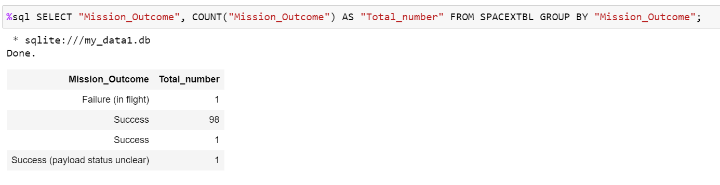
Total Number of Successful and Failure Mission Outcomes
The total number of successful and failure mission outcomes:
There is just 1 failure and 100 successful missions
The result is an SQL query via SQLite in Python.​

Slide 31
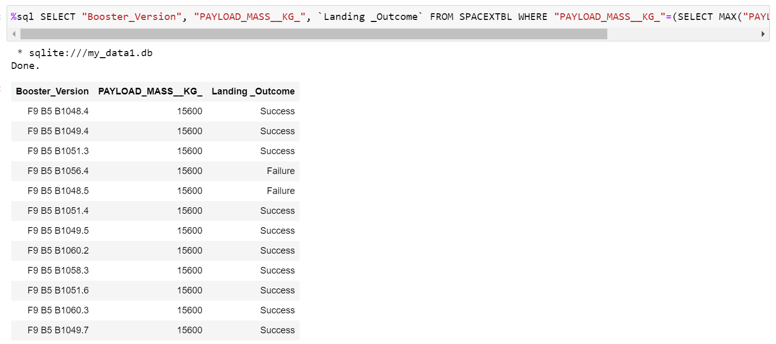
Boosters Carried Maximum Payload
The names of the booster which have carried the maximum payload mass:
The result is an SQL query via SQLite in Python, subquery was used:
%sql SELECT "Booster_Version", "PAYLOAD_MASS__KG_", `Landing _Outcome` FROM SPACEXTBL WHERE "PAYLOAD_MASS__KG_"=(SELECT MAX("PAYLOAD_MASS__KG_") FROM SPACEXTBL);

Slide 32
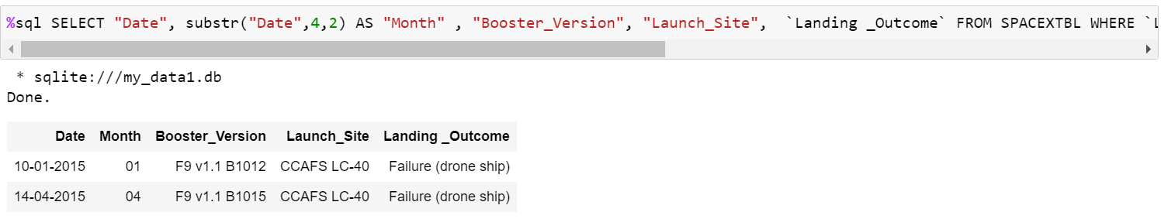
2015 Launch Records
Failed landing outcomes in drone ship, their booster versions, and launch site names for the year 2015:
There 2 cases:
The result is an SQL query via SQLite in Python.​
Code:
%sql SELECT "Date", substr("Date",4,2) AS "Month" , "Booster_Version", "Launch_Site", `Landing _Outcome` FROM SPACEXTBL WHERE `Landing _Outcome` LIKE 'Failure%' and substr("Date",7,4) LIKE '2015' ORDER BY date("Date") DESC

Slide 33
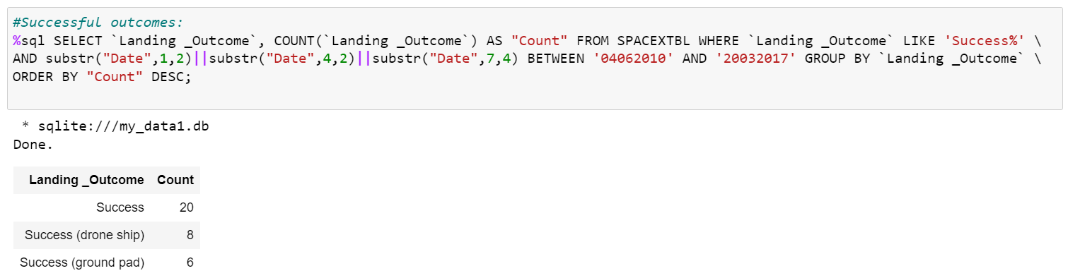
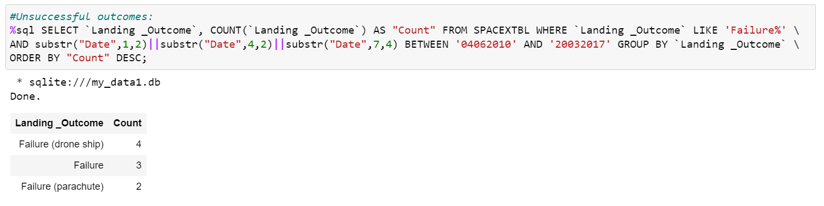
Rank Landing Outcomes Between 2010-06-04 and 2017-03-20
Landing outcomes between the date 2010-06-04 and 2017-03-20, in descending order:
There are 34 Successful outcomes in this period of time.
There 9 Unsuccessful outcomes in the same period.
The result is an SQL query via SQLite in Python using COUNT, GROUP BY and ORDER BY:

Slide 34

Section 3

Slide 35
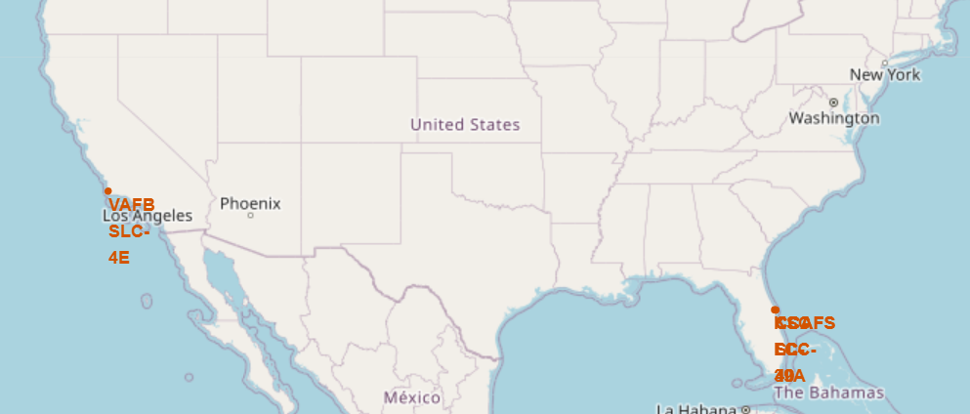
Launch Sites on the map
# | Launch Site | Lat | Long
0 | CCAFS LC-40 | 28.562302 | -80.577356
1 | CCAFS SLC-40 | 28.563197 | -80.576820
2 | KSC LC-39A | 28.573255 | -80.646895
3 | VAFB SLC-4E | 34.632834 | -120.610746
4 Launch Sites were displayed on the map
using Follium.Map():
We can see that VAFB SLC-4E
Site is located far away from
3 other Sites grouped together.

Slide 36
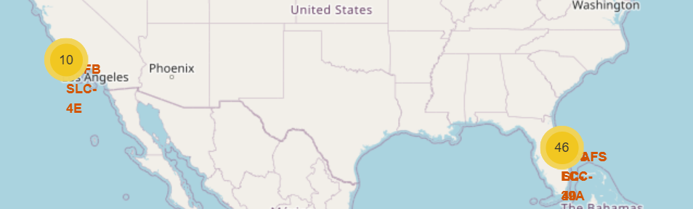
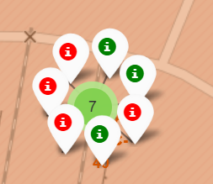
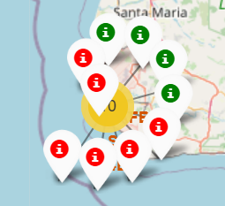
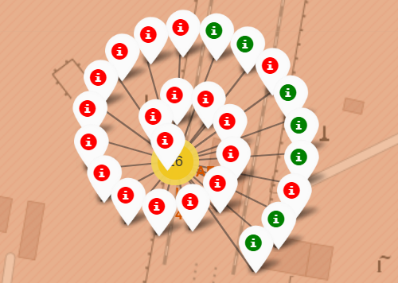
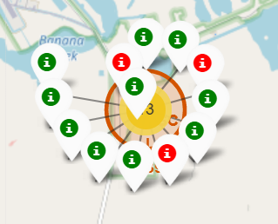
Launch outcomes for each site
Enhanced map by addition the launch outcomes (information from Class column) for each site shows that KSC LC-39A site has the highest success rates.
Color green/red was chosen according to 1/0 Class.

Slide 37
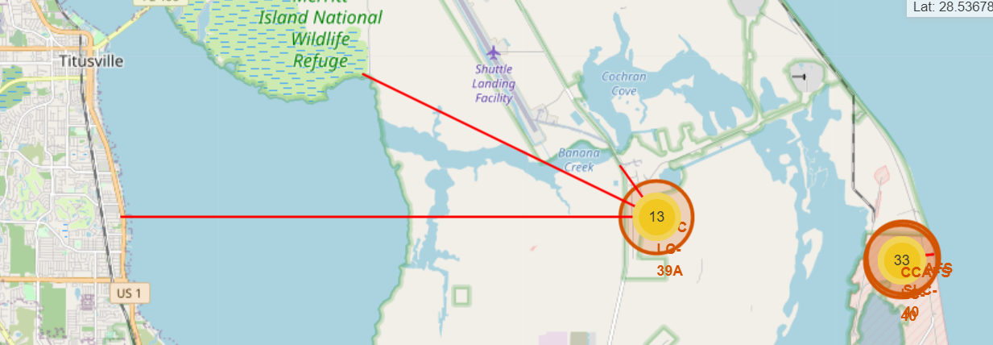
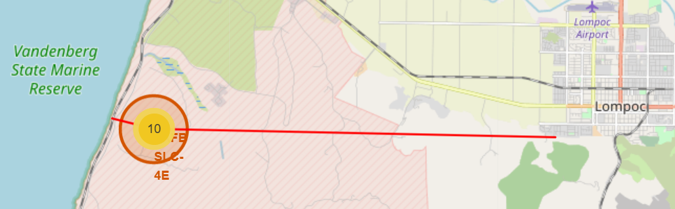
The distances between a launch site to its proximities
Plugins.MousePosition was added to the Folium.Map for fast identefication of coordinates of neighbour objects.
Site [3] is close to coastal line and Marine Reserve (1,2km) and Lompoc city (12km).
Site [2] is close to Wildlife Refege (9km), city Titusville with its railway, highways and airport (15km), Banana Creek river (1,7km). But Lompoc city is smaller than Titusville.
Site [1] is the closest to coastline (0,8km) but further from other surroundings than Site [2] and [3].
Site [2] = KSC LC-39A is the closest to surrounding infrastructure.
Site [2]
Site [1]
Site [3]

Slide 38

Section 4

Slide 39
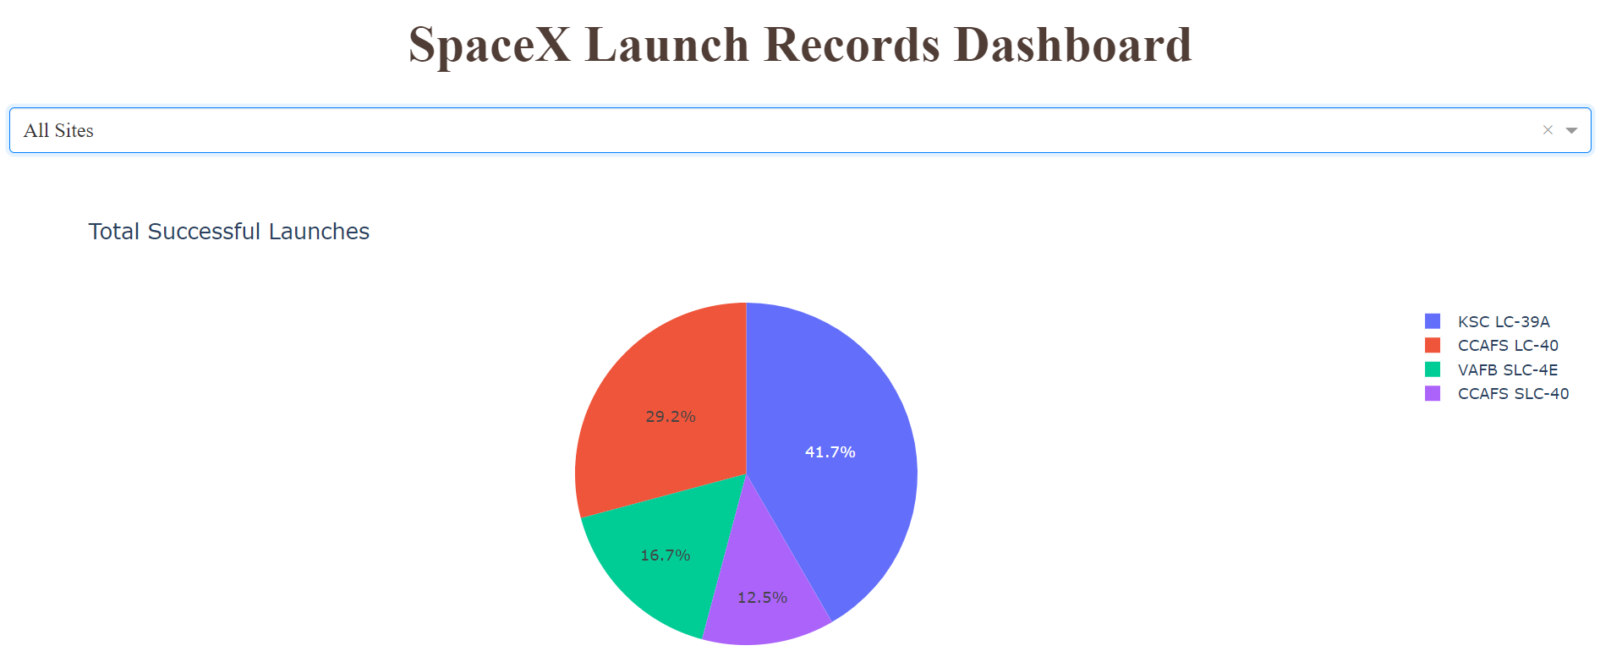
Dashboard with All Sites selection
We can see from the Pie Chart, that the biggest number of successful launches has KSC LC-39A Site and the lowest number – CCAFS SLC-40.

Slide 40
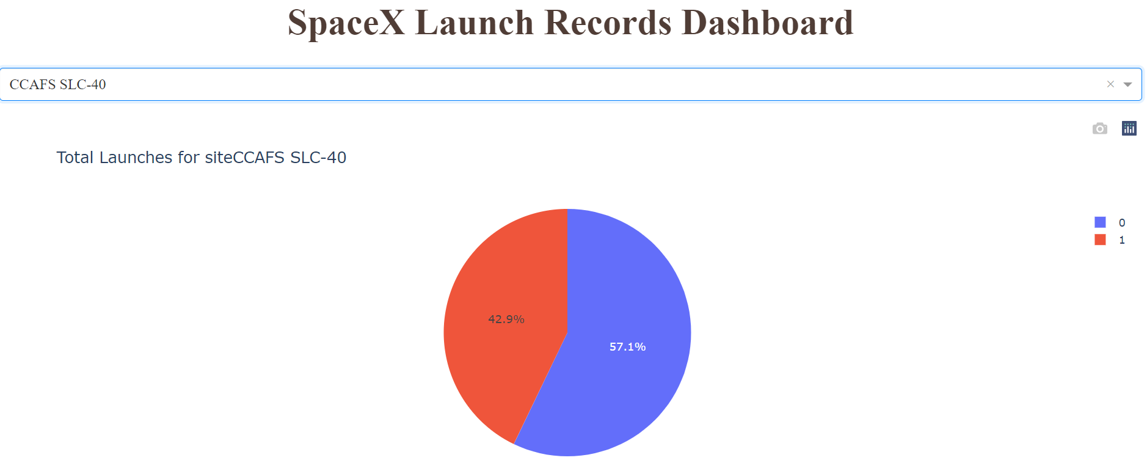
Dashboard with CCAFS LC-40 selection
The Site CCAFS LC-40 has the highest ratio of Success Launches

Slide 41
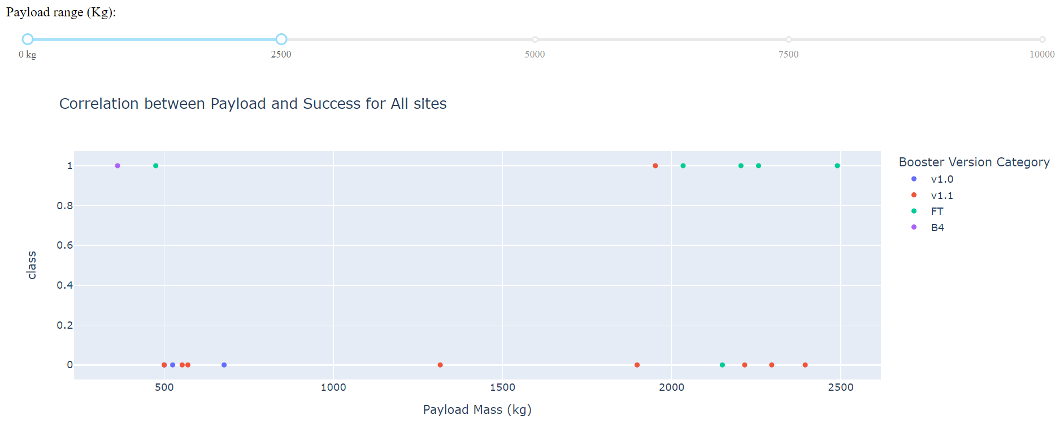
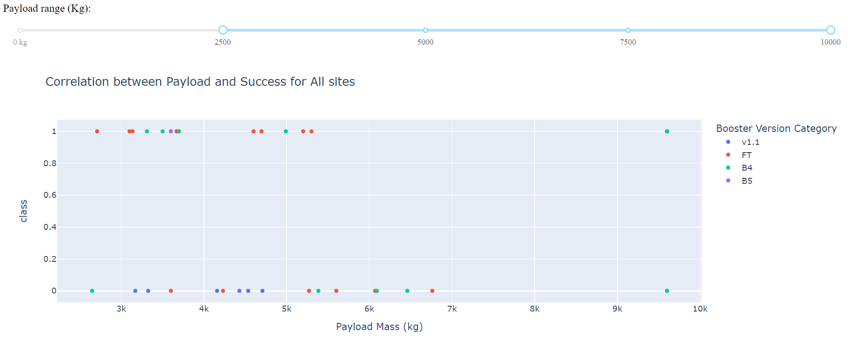
Dashboard with Payload distribution
Based on the scatter plots for All Sites we see, that FT Booster Version has the highest success rate.
Also higher success rate have launches with smaller payload between 2 and 6k kg.

Slide 42

Section 5

Slide 43
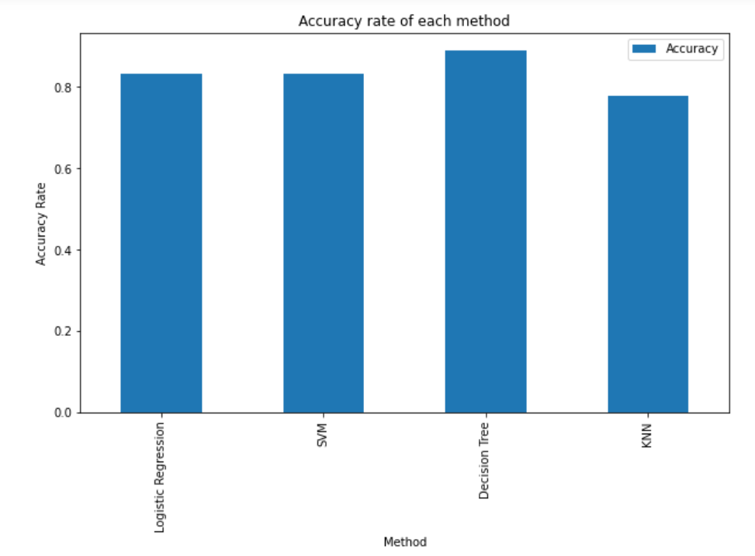
Classification Accuracy
The highest accuracy has Decision Tree Classificator - 0.888889
.
 | Method | Accuracy
0 | Logistic Regression | 0.833333
1 | SVM | 0.833333
2 | Decision Tree | 0.888889
3 | KNN | 0.777778

Slide 44
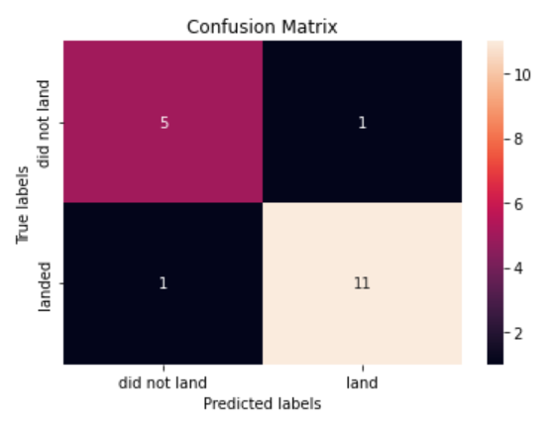
Confusion Matrix
The best performing model - Decision Tree Classifier - can distinguish between the different classes. It found just 1 false positive and 1 false negative (which are the less critical in terms of this project).

Slide 45
Conclusions
The highest success rates have ES-L1, GEO, HEO and SSO orbits.
KSC LC-39A site has the highest success rates among the sites, but in the same time this site is the closest one to civil infrastructure.
The best prediction for launches result can be done with Decision Tree classifier with following accuracy:
Jaccard Score: 0.846
F1 Score: 0.9167
Accuracy: 0.889

Slide 46
Appendix
Orbits description:
LEO: Low Earth orbit (LEO)is an Earth-centred orbit with an altitude of 2,000 km (1,200 mi) or less (approximately one-third of the radius of Earth),[1] or with at least 11.25 periods per day (an orbital period of 128 minutes or less) and an eccentricity less than 0.25.[2] Most of the manmade objects in outer space are in LEO [1].
VLEO: Very Low Earth Orbits (VLEO) can be defined as the orbits with a mean altitude below 450 km. Operating in these orbits can provide a number of benefits to Earth observation spacecraft as the spacecraft operates closer to the observation[2].
GTO A geosynchronous orbit is a high Earth orbit that allows satellites to match Earth's rotation. Located at 22,236 miles (35,786 kilometers) above Earth's equator, this position is a valuable spot for monitoring weather, communications and surveillance. Because the satellite orbits at the same speed that the Earth is turning, the satellite seems to stay in place over a single longitude, though it may drift north to south,” NASA wrote on its Earth Observatory website [3] .
SSO (or SO): It is a Sun-synchronous orbit also called a heliosynchronous orbit is a nearly polar orbit around a planet, in which the satellite passes over any given point of the planet's surface at the same local mean solar time [4] .
ES-L1 :At the Lagrange points the gravitational forces of the two large bodies cancel out in such a way that a small object placed in orbit there is in equilibrium relative to the center of mass of the large bodies. L1 is one such point between the sun and the earth [5] .
HEO A highly elliptical orbit, is an elliptic orbit with high eccentricity, usually referring to one around Earth [6].
ISS A modular space station (habitable artificial satellite) in low Earth orbit. It is a multinational collaborative project between five participating space agencies: NASA (United States), Roscosmos (Russia), JAXA (Japan), ESA (Europe), and CSA (Canada) [7]
MEO Geocentric orbits ranging in altitude from 2,000 km (1,200 mi) to just below geosynchronous orbit at 35,786 kilometers (22,236 mi). Also known as an intermediate circular orbit. These are "most commonly at 20,200 kilometers (12,600 mi), or 20,650 kilometers (12,830 mi), with an orbital period of 12 hours [8]
HEO Geocentric orbits above the altitude of geosynchronous orbit (35,786 km or 22,236 mi) [9]
GEO It is a circular geosynchronous orbit 35,786 kilometres (22,236 miles) above Earth's equator and following the direction of Earth's rotation [10]
PO It is one type of satellites in which a satellite passes above or nearly above both poles of the body being orbited (usually a planet such as the Earth [11]

Slide 47


